Slide 1



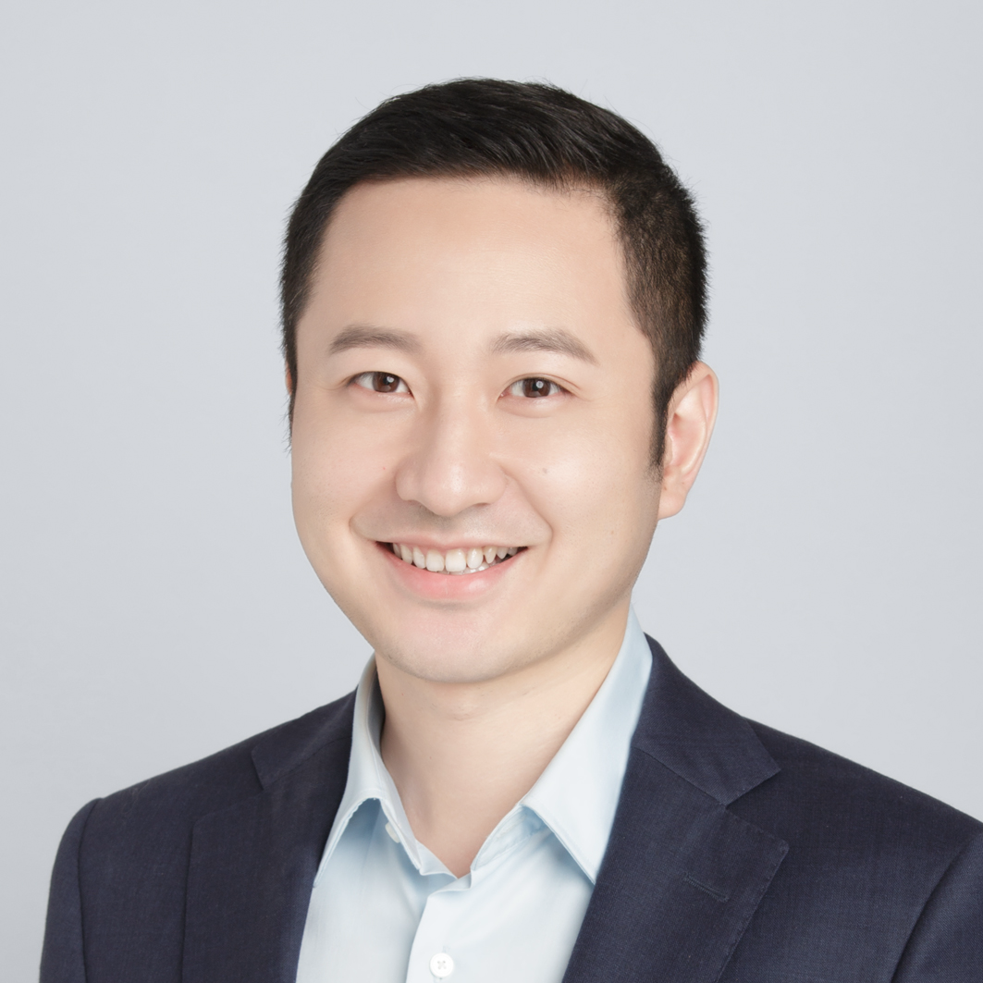

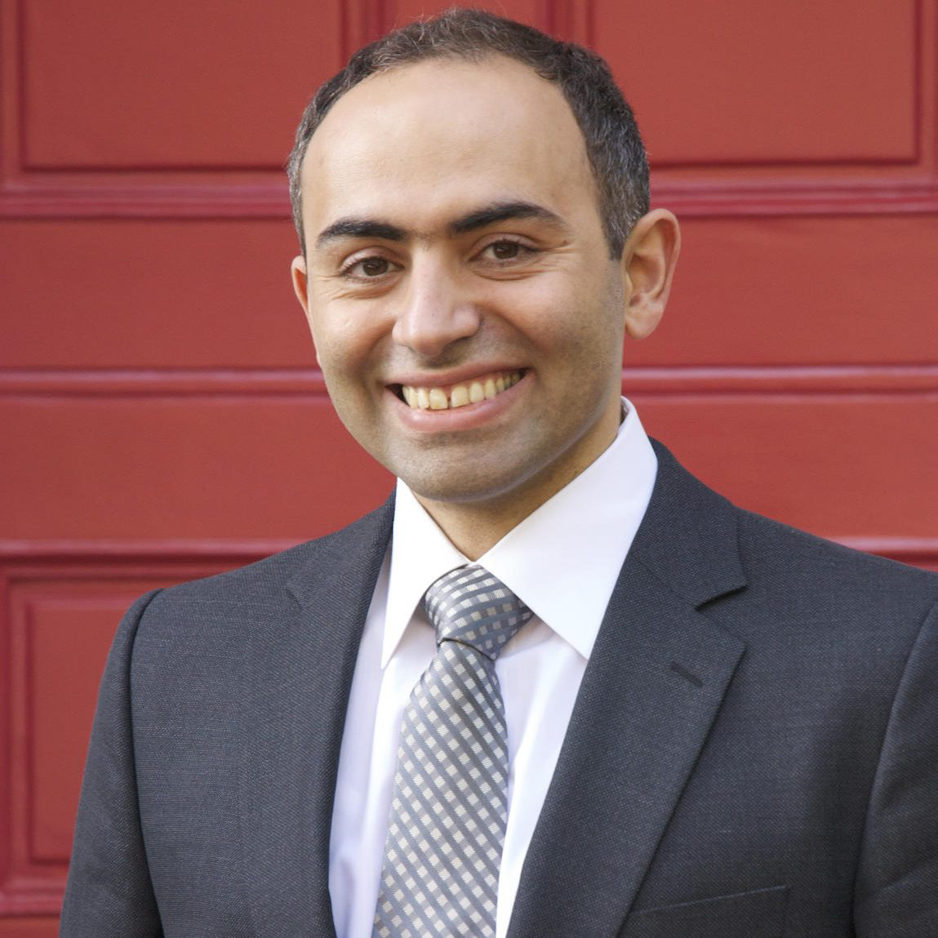


Dividing and Conquering a BlackBox to a Mixture of Interpretable Models: Route, Interpret, Repeat
Shantanu Ghosh¹, Ke Yu², Forough Arabshahi³, Kayhan Batmanghelich¹
¹BU, ²Pitt ISP, ³Meta
Notes:
Hi I am Shantanu to present my paper at this year’s ICML.

Slide 2
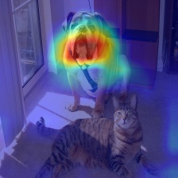
DL model explanation is dichotomous
Create
a
Blackbox
2
1
Explain post-hoc
Saliency Maps. Simonyan et al. arXiv 2014.
CAM. Zhou et al. CVPR 2016.
GRAD-CAM. Selvaraju et al. ICCV 2017.
SmoothGrad. Smilkov et al. ICML 2017 and more..
Notes:
Deep learning model explanation is dichotomous. Either we create a Blackbox and explain it post-hoc.

Slide 3
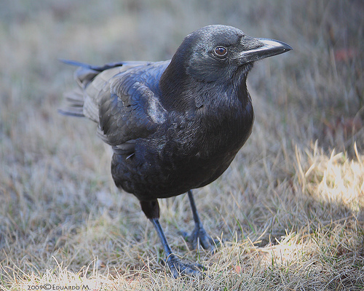
DL model explanation is dichotomous
Concepts
CNN
bill_length_shorter_than_head
Classifier
bill_shape_allpurpose
Common Raven
wing_shape_roundedwings
…
Concept Bottleneck Model. Koh et al. ICML 2020
Concept Embedding Models. Zarlenga et al. Neurips 2022
Ante-hoc Explainable Model. Sarkar et al. CVPR 2022
E-LENs Barbiero et al. AAAI 2022 and more..
Concepts are learned either from training dataset (CUB-200) or using some datasets (HAM10000 or SIIM-ISIC) or reports (MIMIC-CXR)
Notes:
Or create a model that is explicitly interpretable. For example concept bottleneck models where we first predict concepts from images and then class labels from the concepts

Slide 4
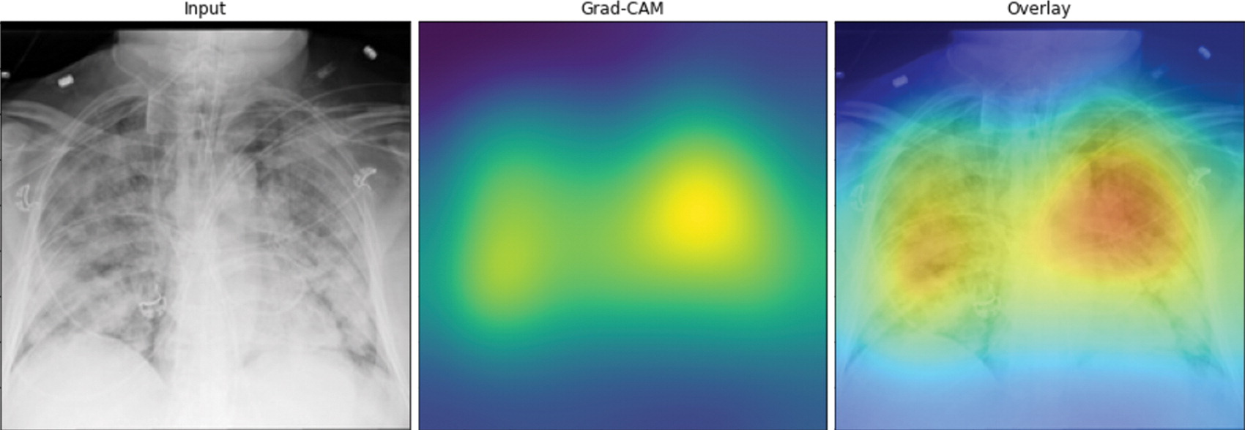
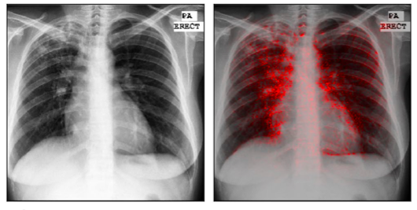
Post-hoc explanations fails on CXRs
Poor localization
Affinity for edges
Picture credit: DeepCOVID-XR: An Artificial Intelligence Algorithm to Detect COVID-19
on Chest Radiographs Trained and Tested on a Large U.S. Clinical Data Set
Picture credit: Identifying pneumonia in chest X-rays: A deep learning approach
Notes:
post-hoc methods have some drawbacks. Here they highlight the whole lungs or have a propensity to highlight edges.

Slide 5
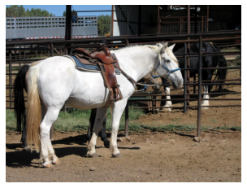
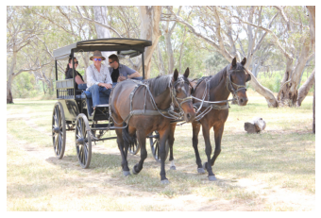
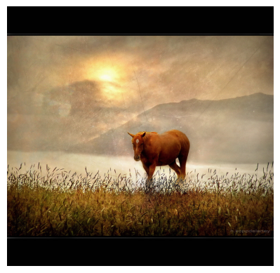
CBM explanations are generic

Slide 6
CBM offers inferior performance
Generic explanations
Poor performance on real life datasets (MIMIC-CXR)
0.92
0.91
0.78
0.84
AUROC
0.75
0.72
CBM (Sequential)
Blackbox
Effusion
Pneumothorax
Cardiomegaly
Notes:
On the other hand, CBMs fits a single classifier which offers poor performance compared to the Blackbox and generic explanations.

Slide 7
We extract a mixture of concept based
interpretable models from a Blackbox
iteratively.
Notes:
In this regard, We extract a mixture of concept based interpretable models from a Blackbox iteratively.

Slide 8
Route, interpret and repeat
Notes:
Assume the Blackbox to be a composition of encoder phi and a classifier h.

Slide 9
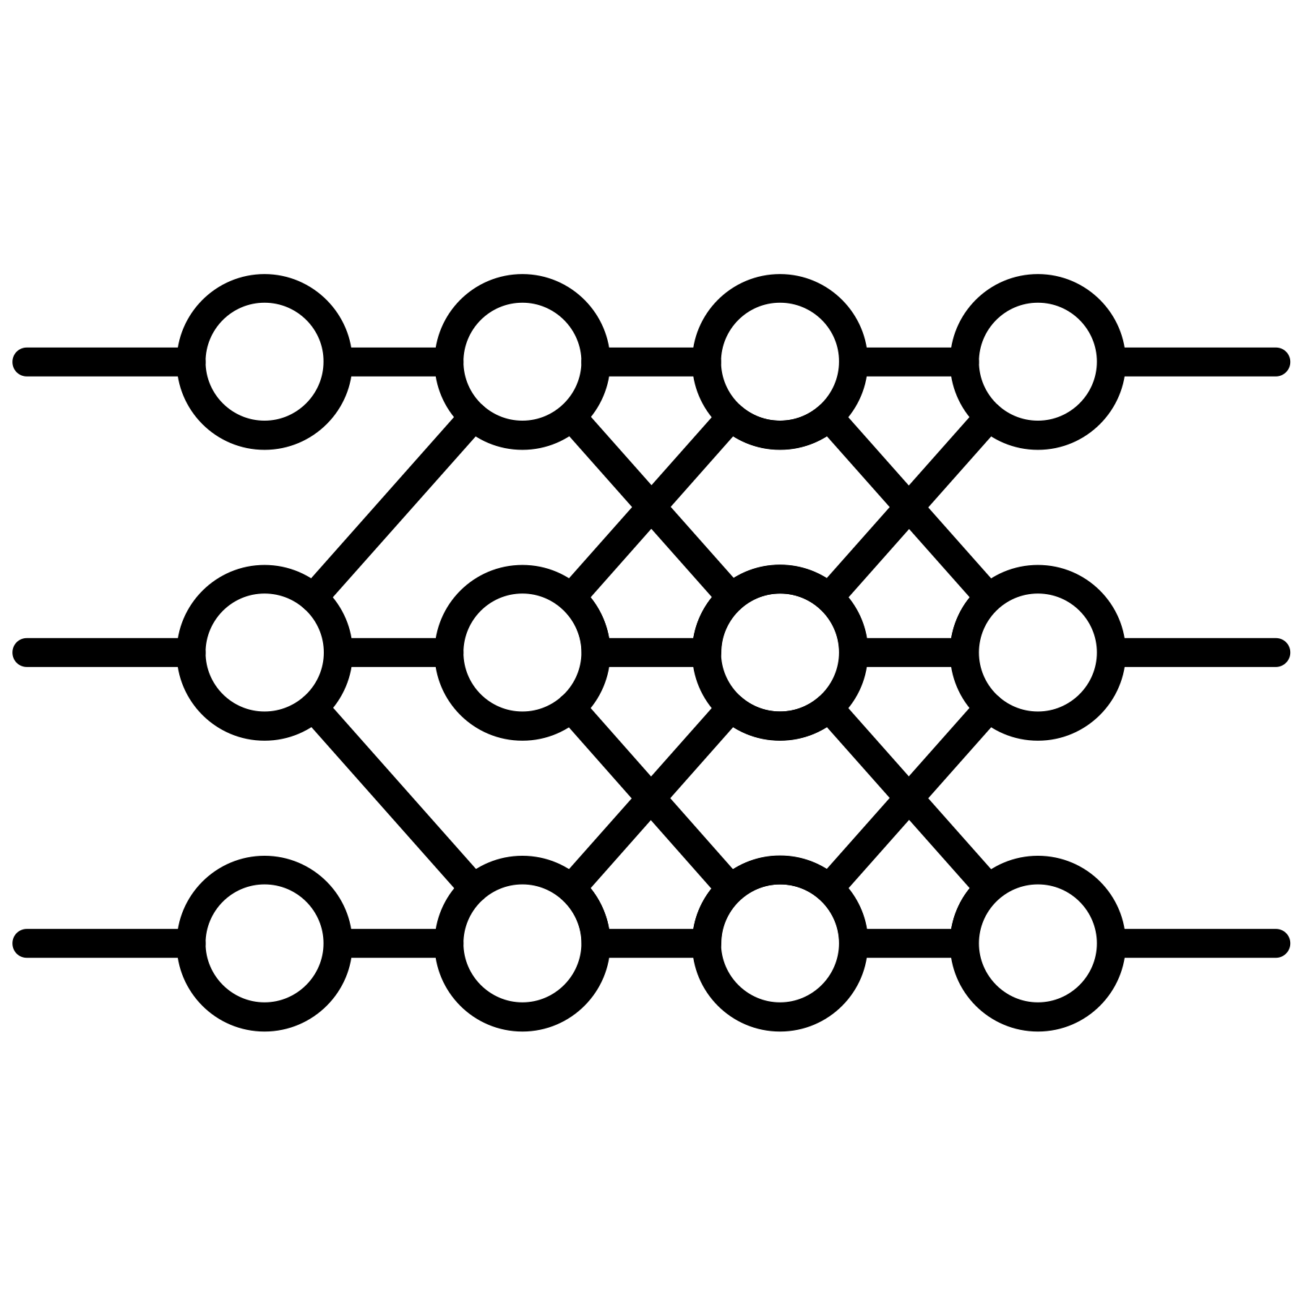



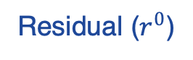
Route, interpret and repeat
Residual ($r^{0}$)
Blackbox Model
Symbolic Model
Selector
Notes:
We start with a given Blackbox and extract the first interpretable model g in the first iteration.

Slide 10

Route, interpret and repeat
Selector
Residual ($r^{0}$)
Interpretable model
Blackbox Model
Symbolic Model
Selector
Notes:
We have a predefined coverage of samples which interpretable model should cover. A probabilistic selector selects the subset of data based on that coverage and the interpretable model specializes on that subset.

Slide 11
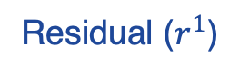
Route, interpret and repeat
Fix
Residual ($r^{0}$)
Residual ($r^{1}$)
Blackbox Model
Symbolic Model
Selector
Notes:
There will be part of the BlackBox that the interpretable model does not approximate well; we term it as residual. We finetune the classifier h of the residual to create a black box for the next iteration.

Slide 12
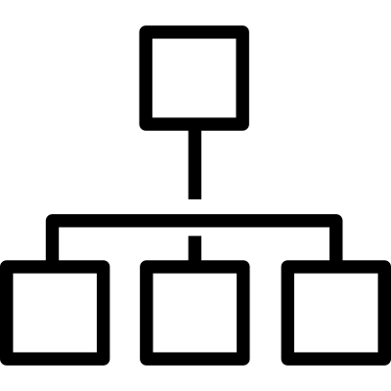
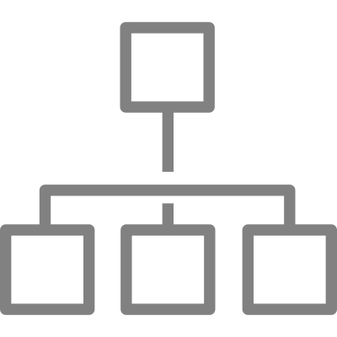
Route, interpret and repeat
Fix
Residual ($r^{0}$)
Residual ($r^{1}$)
Blackbox Model
Symbolic Model
Selector
Notes:
And we continue like wise.

Slide 13
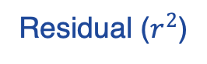
Route, interpret and repeat
Fix
Residual ($r^{0}$)
Residual ($r^{1}$)
Residual ($r^{2}$)
Blackbox Model
Symbolic Model
Selector

Slide 14
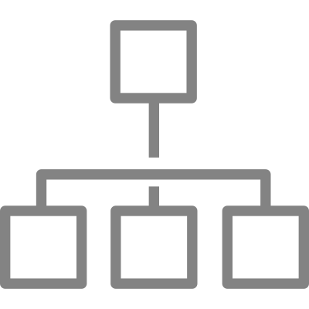
Route, interpret and repeat
Fix
Residual ($r^{0}$)
Residual ($r^{1}$)
Residual ($r^{2}$)
Blackbox Model
Symbolic Model
Selector

Slide 15
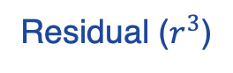
Route, interpret and repeat
Fix
Residual ($r^{0}$)
Residual ($r^{1}$)
Residual ($r^{2}$)
Residual ($r^{3}$)
Blackbox Model
Symbolic Model
Selector
Components in black and grey indicate the fixed and trainable modules in our model, respectively

Slide 16
Route, interpret and repeat
Fix
Residual ($r^{0}$)
Residual ($r^{1}$)
Residual ($r^{2}$)
Residual ($r^{3}$)
Blackbox Model
Symbolic Model
Selector
All interpretable models (g) is called Mixture of interpretable experts (MoIE).
Each g is E-LENs (Barberio et al. AAAI 2022) to produce sample specific FOLs.
Notes:
After the training, more samples will be covered by the interpretable models cumulatively. We call them Mixture of interpretable experts. We use Entropy-LENs as each expert to produce sample specific First order logic expression to explain the prediction. Through out the process the encoder phi is fixed

Slide 17
Experiments
Fine grained classification datasets
CUB-200
AWA2
Medical Imaging datasets
HAM10000
SIIM-ISIC
MIMIC-CXR (Effusion)
https://github.com/batmanlab/ICML-2023-Route-interpret-repeat#downloading-data
Notes:
We experimented with wide range of datasets

Slide 18
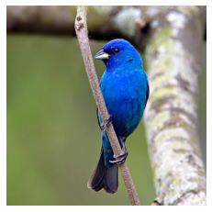
Baselines
CNN / VIT
Logistic
classifier
Indigo Bunting
Indigo Bunting
+
FOL
E-LENs
Replace the standard logistic classifiers in CBM (Koh et el. ICML 2020) and
post-hoc CBM (Yuksekgonul et al. ICLR 2023) with E-LENs to compare the FOLs
Notes:
To compare the FOLs, we replace the standard logistic classifiers in CBM and PCBM with E-LENs

Slide 19
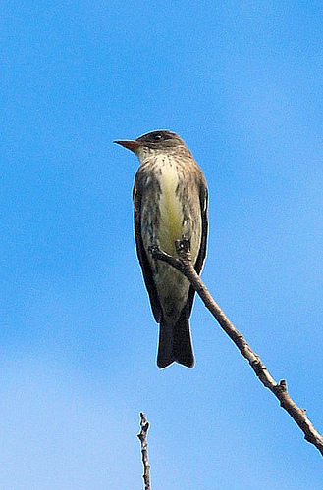
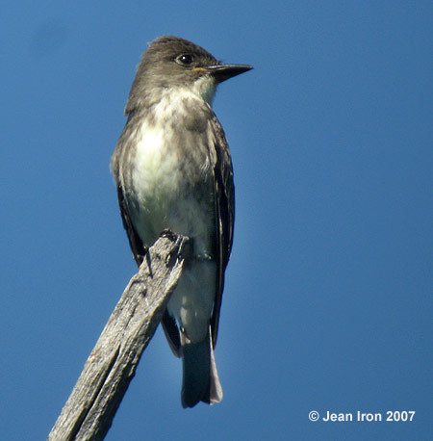
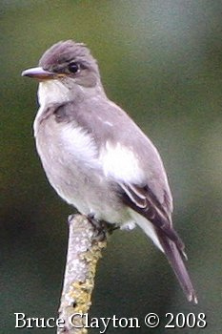
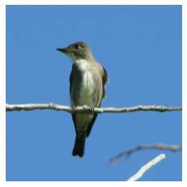
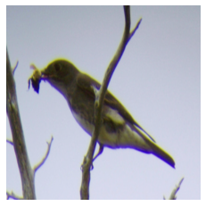
MoIE identifies diverse concepts
MoIE
Colored concepts are unique to the corresponding expert.
Underlined concepts matches the baselines.
Notes:
First we show our method identifies diverse concepts

Slide 20
MoIE identifies diverse concepts
MoIE
Colored concepts are unique to the corresponding expert.
Underlined concepts matches the baselines.

Slide 21
MoIE identifies diverse concepts
MoIE
Expert4
Colored concepts are unique to the corresponding expert.
Underlined concepts matches the baselines.
Notes:
Here breast color grey and tail pattern solid are unique to Expert 4 for these four samples to identify them as olive sided flycatcher

Slide 22
MoIE identifies diverse concepts
MoIE
Expert4
Colored concepts are unique to the corresponding expert.
Underlined concepts matches the baselines.

Slide 23
MoIE identifies diverse concepts
MoIE
Expert4
Colored concepts are unique to the corresponding expert.
Underlined concepts matches the baselines.

Slide 24
MoIE identifies diverse concepts
MoIE
Expert4
Expert6
Colored concepts are unique to the corresponding expert.
Underlined concepts matches the baselines.
Notes:
Similarly, underparts color grey and wing color grey are unique to Expert 6 to identify this sample as olive sided flycatcher.

Slide 25
MoIE identifies diverse concepts
MoIE
Expert4
Expert6
Final Residual (Unexplained)
Colored concepts are unique to the corresponding expert.
Underlined concepts matches the baselines.
Notes:
Finally this sample remains unexplained and covered by the final residual.

Slide 26
MoIE identifies diverse concepts
MoIE
Expert4
PCBM + E-LEN
Expert6
Final Residual (Unexplained)
Colored concepts are unique to the corresponding expert.
Underlined concepts matches the baselines.
Notes:
FOLs from the baselines consists of generic concepts.

Slide 27
MoIE identifies diverse concepts
MoIE
Expert4
PCBM + E-LEN
Expert6
CBM + E-LEN
Final Residual (Unexplained)
Colored concepts are unique to the corresponding expert.
Underlined concepts matches the baselines.

Slide 28
MoIE does not compromise performance
Notes:
Next we show our method does not compromise the performance of Black box. First we report results on computer vision datasets.

Slide 29
MoIE does not compromise performance
Notes:
We can see that our method achieves better performance than the baselines.

Slide 30
MoIE does not compromise performance
Notes:
Same for other datasets and architectures

Slide 31
MoIE does not compromise performance

Slide 32
MoIE does not compromise performance

Slide 33
MoIE does not compromise performance

Slide 34
MoIE does not compromise performance
Notes:
Next we show the same for medical imaging datasets. Here also out method achieves superior performance

Slide 35
MoIE does not compromise performance
* Concepts for skin datasets are extracted from pretrained model, so CBM and other interpretable by design models are not possible for HAM10000 and SIIM-ISIC

Slide 36
MoIE does not compromise performance
* Concepts for skin datasets are extracted from pretrained model, so CBM and other interpretable by design models are not possible for HAM10000 and SIIM-ISIC

Slide 37
MoIE does not compromise performance
* Concepts for skin datasets are extracted from pretrained model, so CBM and other interpretable by design models are not possible for HAM10000 and SIIM-ISIC

Slide 38
MoIE does not compromise performance

Slide 39
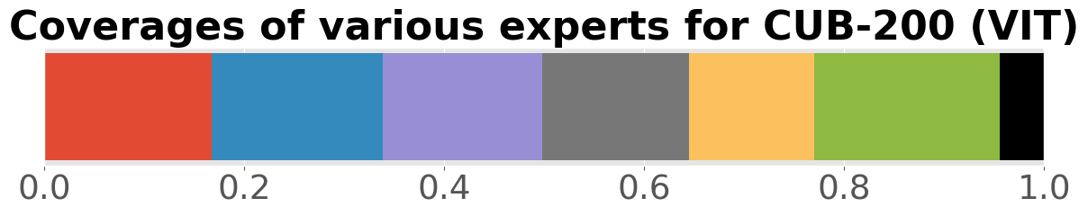
Residuals gradually perform poorly
Notes:
In this experiment we show that the residuals perform poorly across iterations.

Slide 40
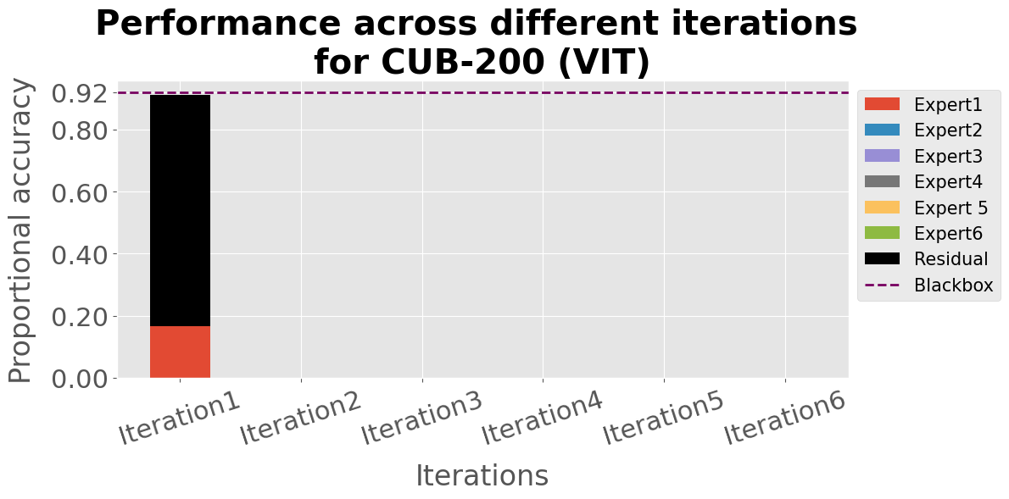
Residuals gradually perform poorly
Notes:
In the first iteration residual contributes more to the cumulative performance than the first expert.

Slide 41
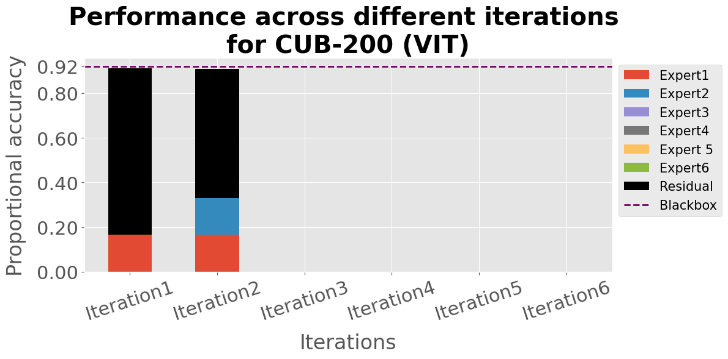
Residuals gradually perform poorly
Notes:
For later iterations, the contribution of residual to the cumulative performance shrinks.

Slide 42
Residuals gradually perform poorly
Notes:
show by the red rectangles.

Slide 43
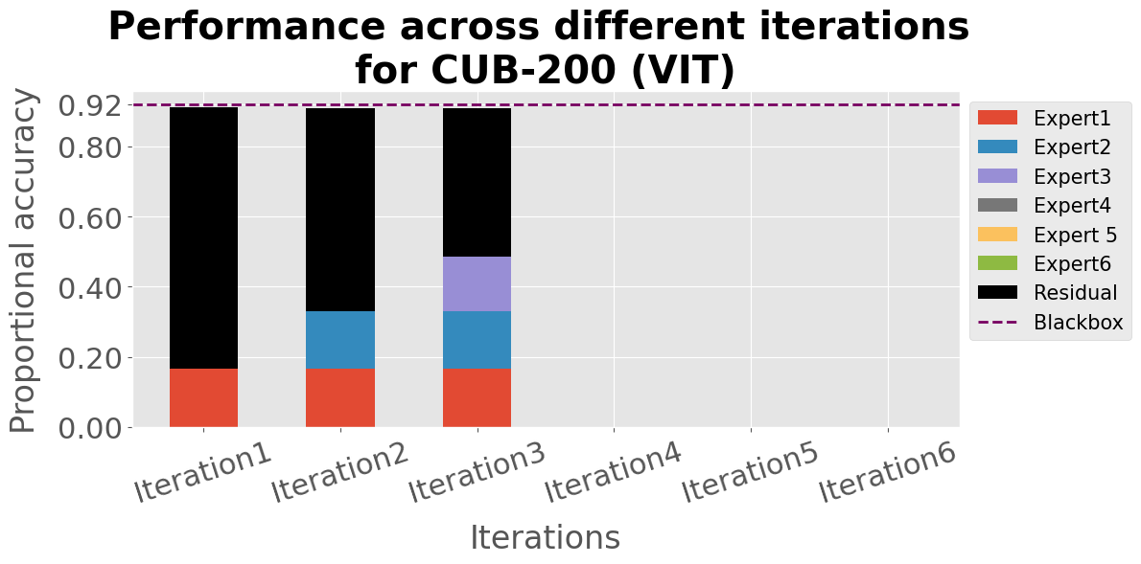
Residuals gradually perform poorly
Notes:
And it continues like wise

Slide 44
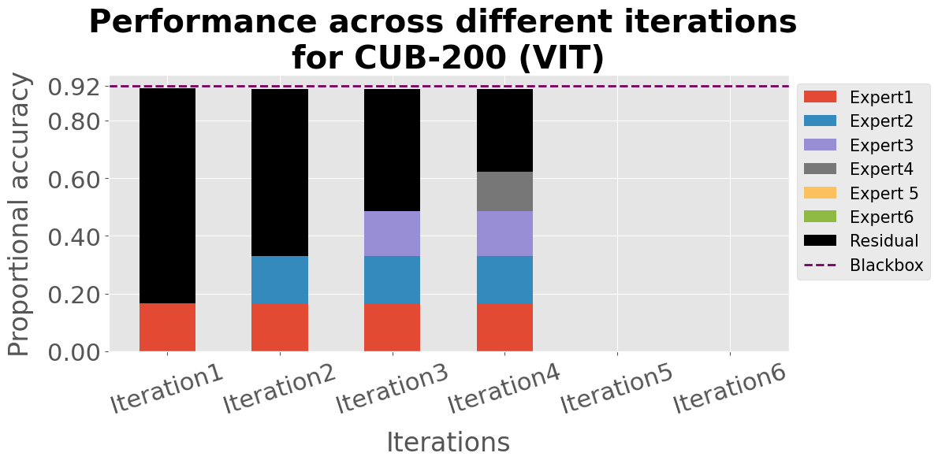
Residuals gradually perform poorly

Slide 45
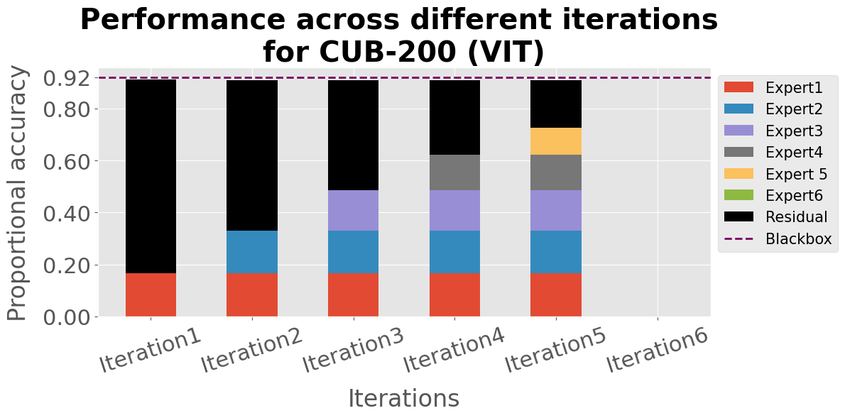
Residuals gradually perform poorly

Slide 46
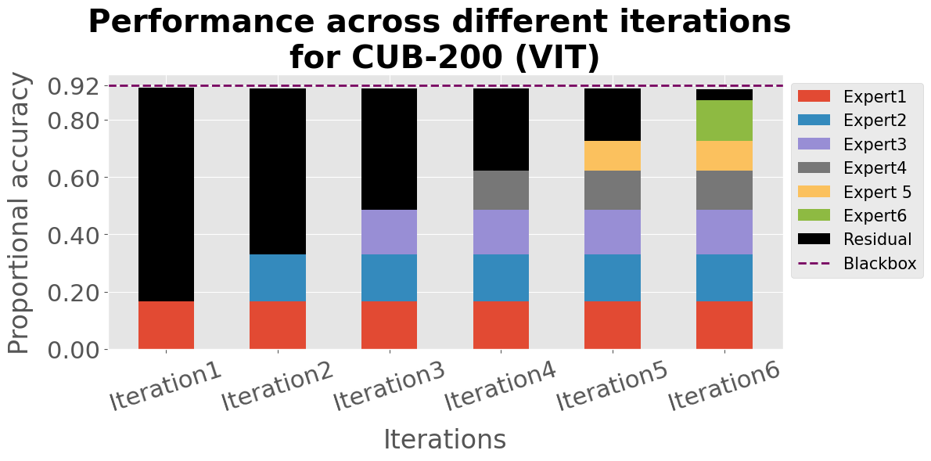
Residuals gradually perform poorly

Slide 47
Residuals gradually perform poorly

Slide 48
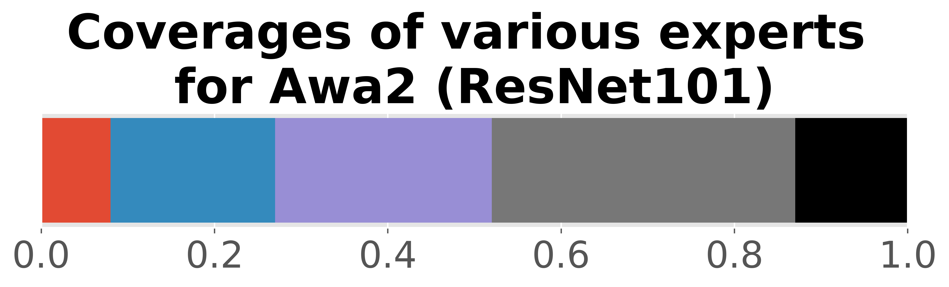
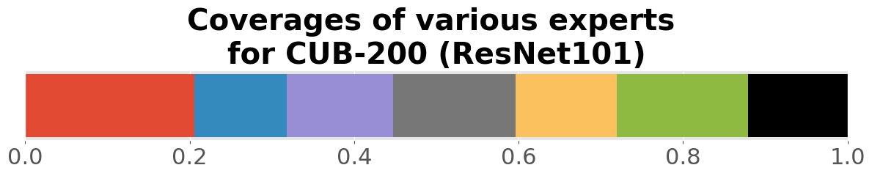
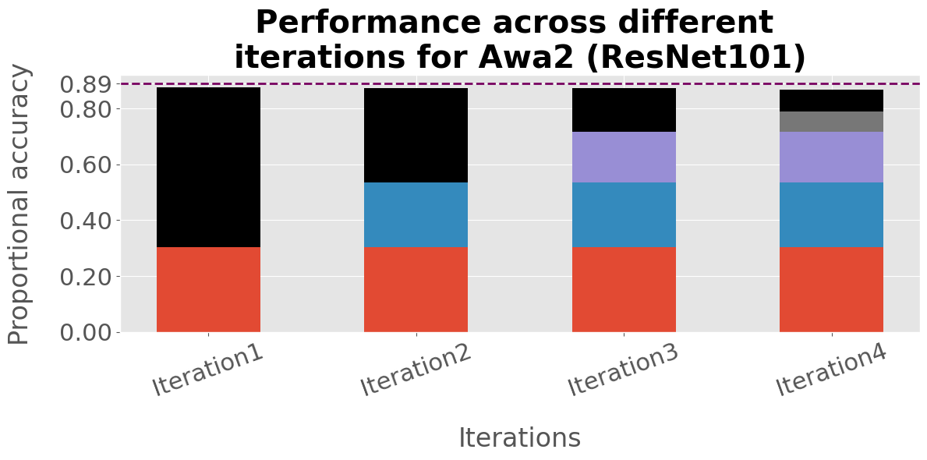
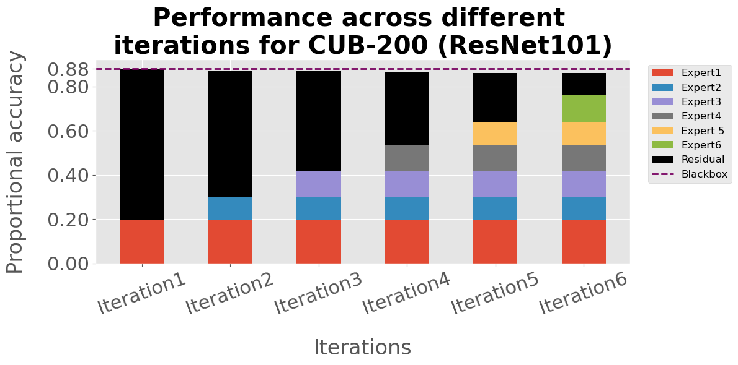
Residuals gradually perform poorly
Same story for other datasets and architectures
Notes:
And this is same for others.

Slide 49
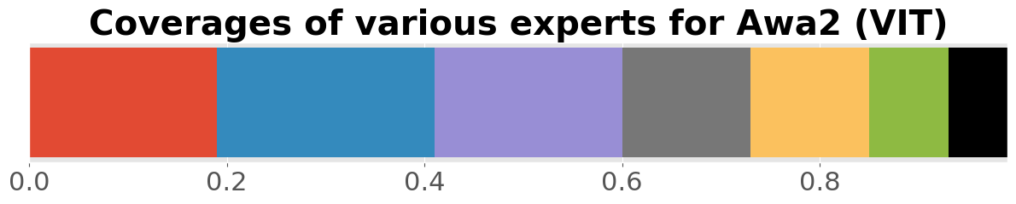
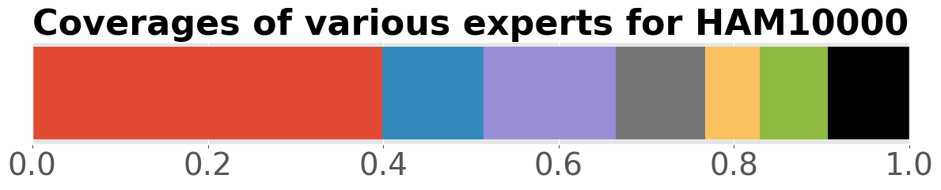
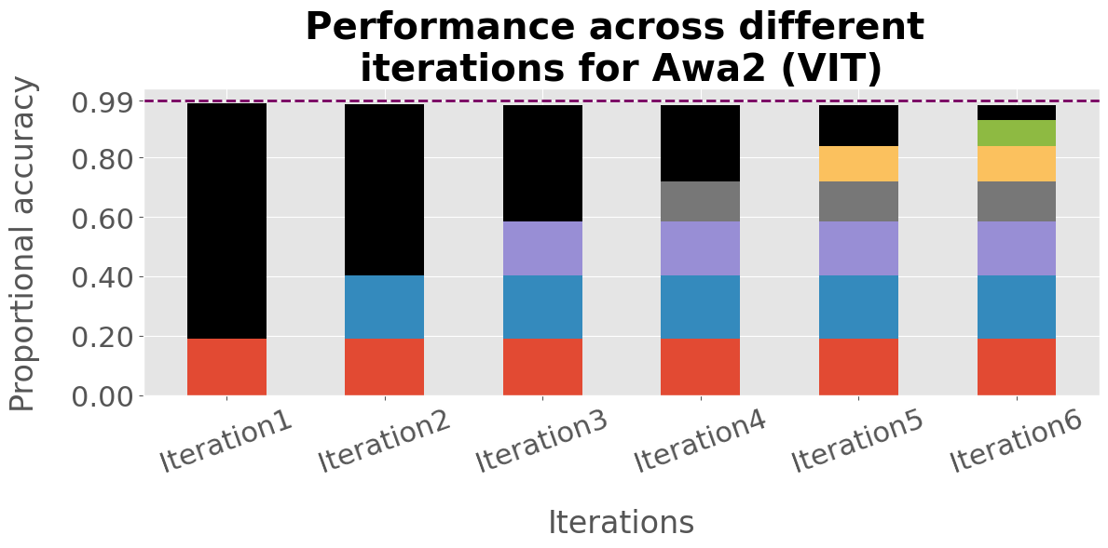
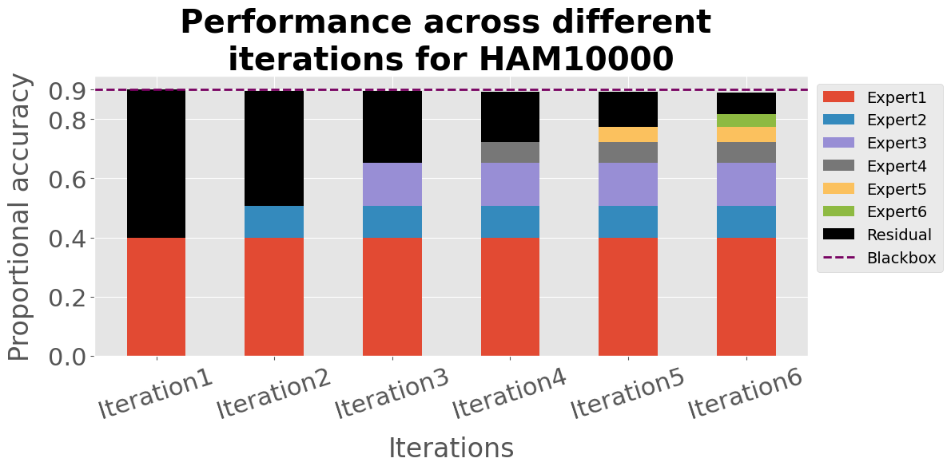
Residuals gradually perform poorly
Same story for other datasets and architectures
Notes:
This is because the residuals in later iterations cover harder examples.

Slide 50
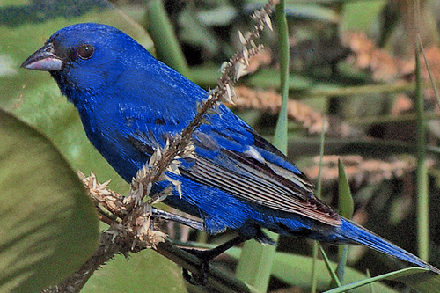
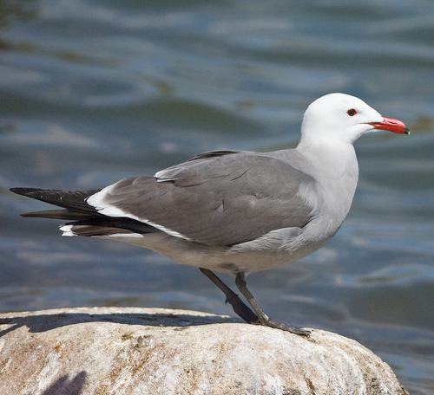
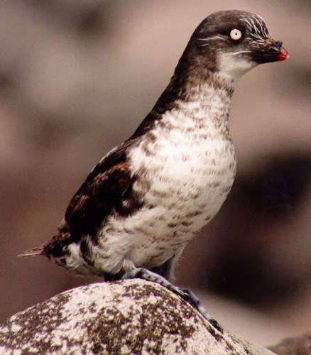
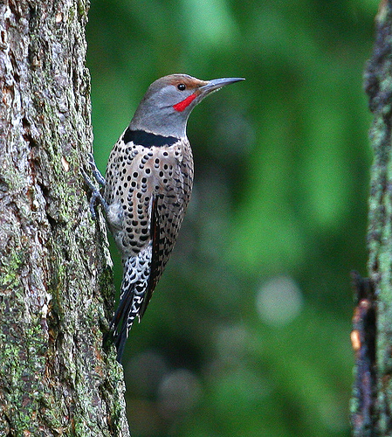
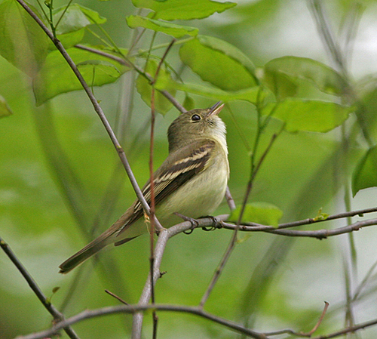
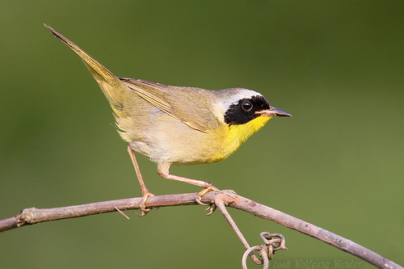
Later residuals cover harder samples

Slide 51
Later residuals cover harder samples
Notes:
To prove it, we first select the samples covered by each residual.

Slide 52
Later residuals cover harder samples
Performance
Notes:
And compute the performance

Slide 53
Later residuals cover harder samples
Performance
Notes:
Then we route them to the initial black box

Slide 54
Later residuals cover harder samples
Performance
Performance
Notes:
And compute the performance

Slide 55
Later residuals cover harder samples
Performance
Compare
Performance
Notes:
And compare this two.

Slide 56
Later residuals cover harder samples
Performance
Compare
Performance
Performance
Compare
…
Performance

Slide 57
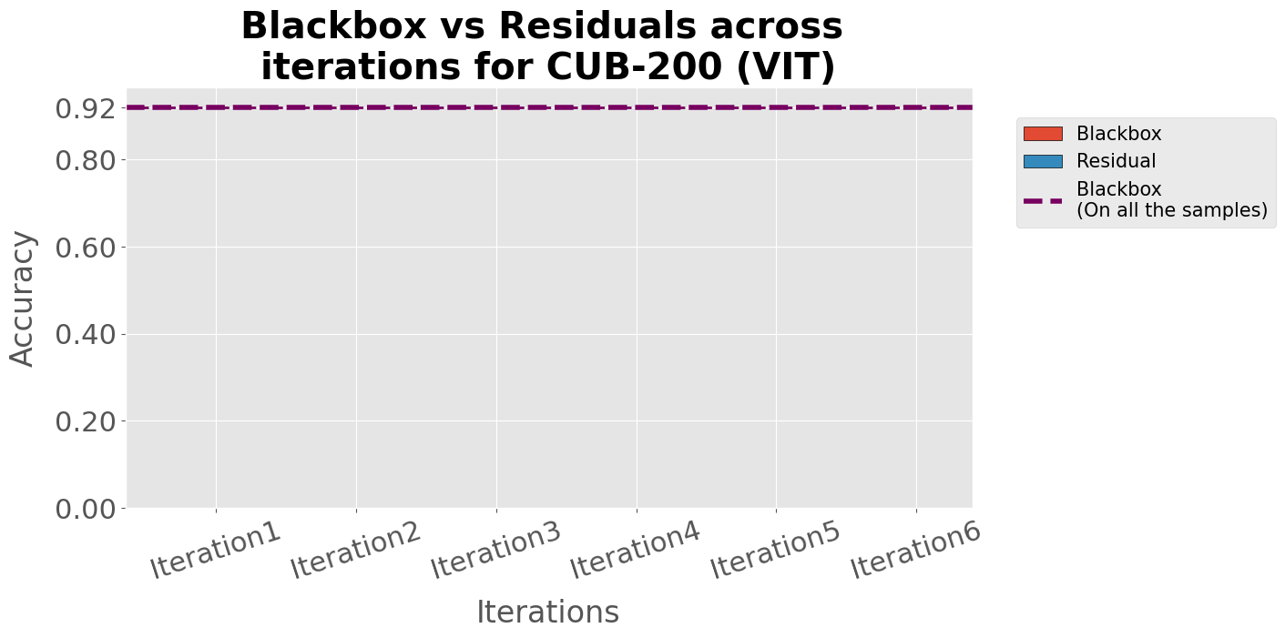
Later residuals cover harder samples
Notes:
We finally plot it for all the iterations

Slide 58
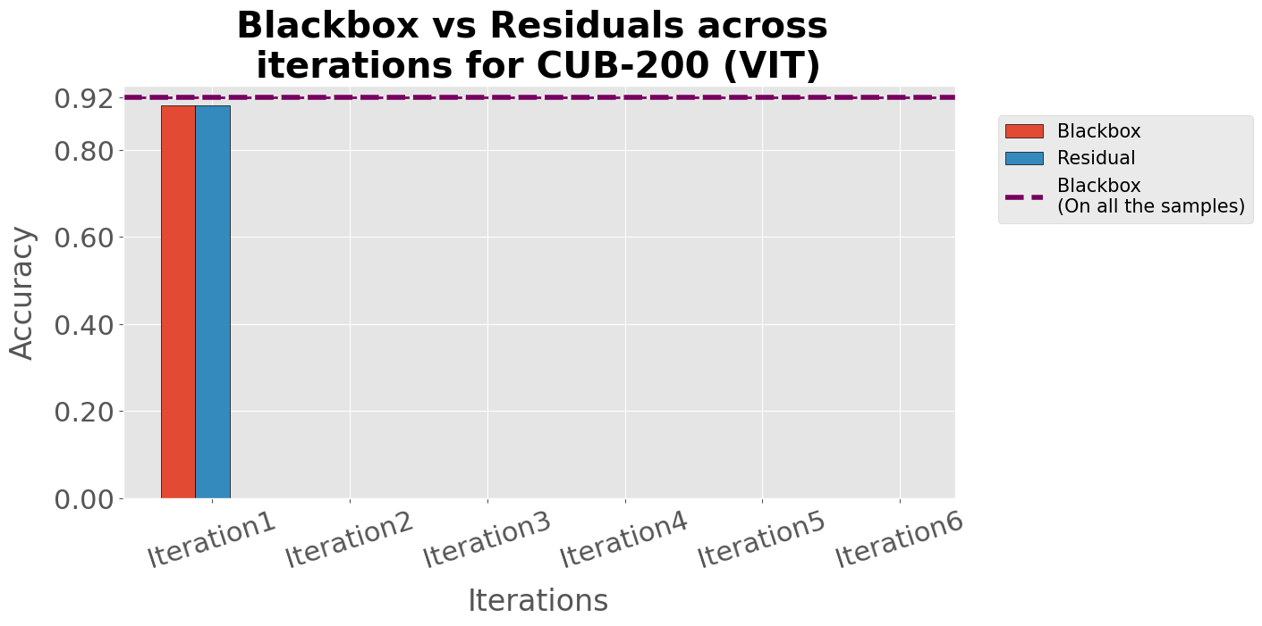
Later residuals cover harder samples

Slide 59
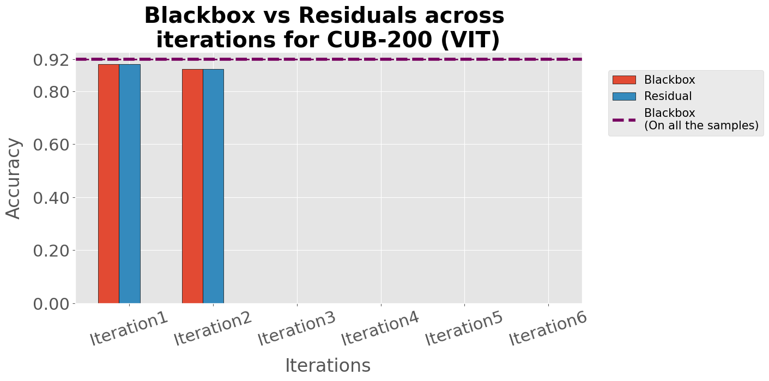
Later residuals cover harder samples

Slide 60
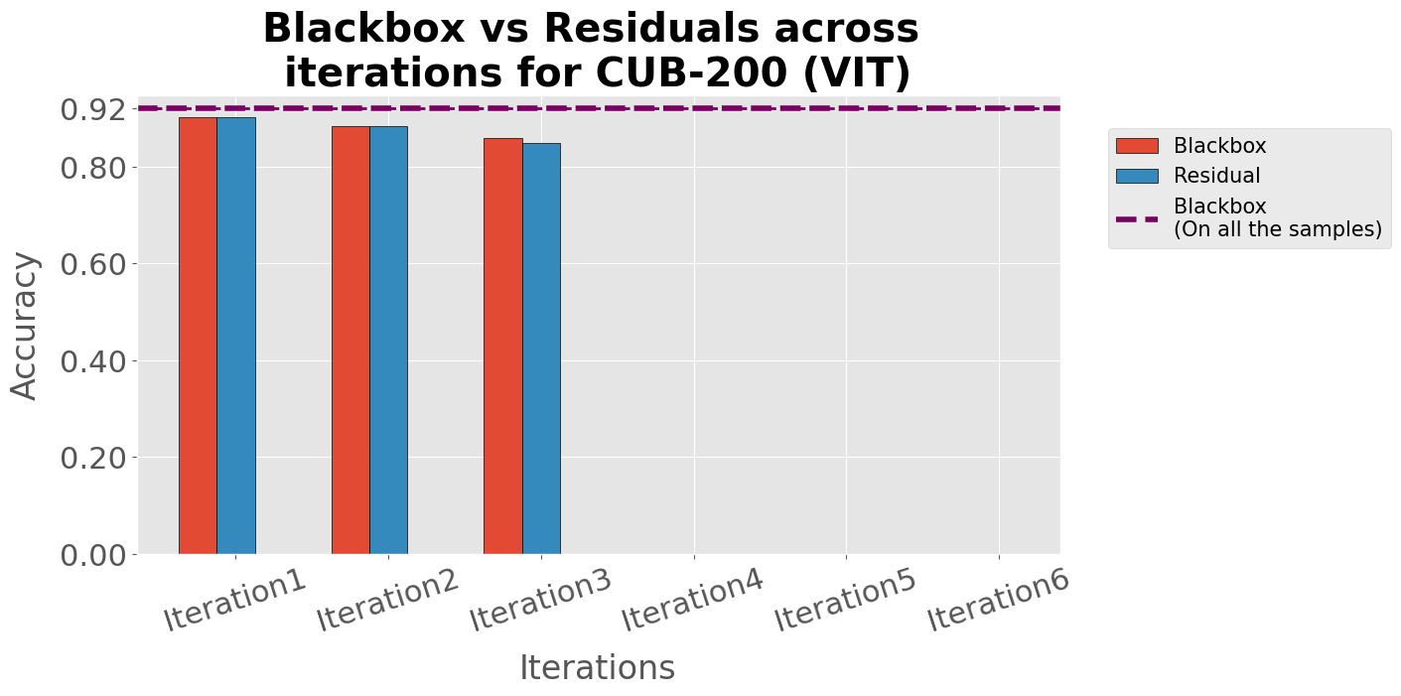
Later residuals cover harder samples

Slide 61
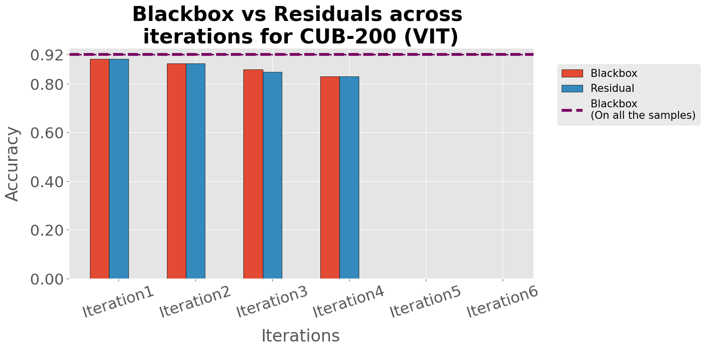
Later residuals cover harder samples

Slide 62
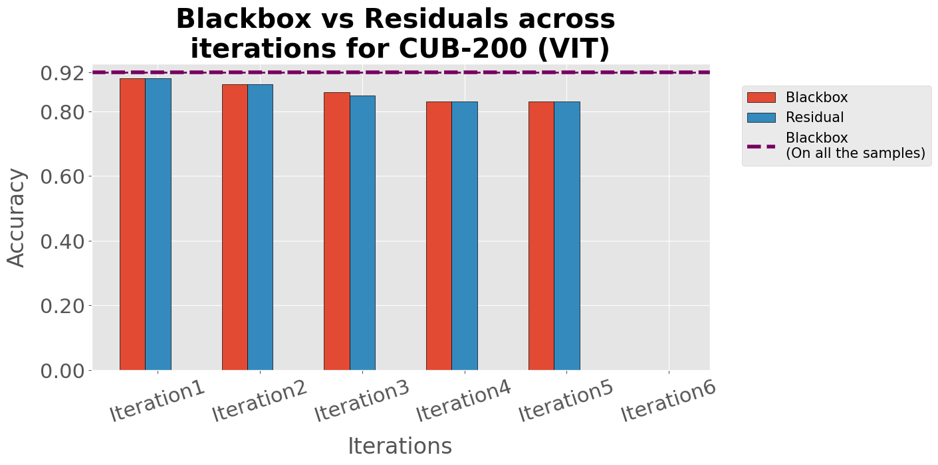
Later residuals cover harder samples

Slide 63

Later residuals cover harder samples
Notes:
We see that the performance drops for both the residual and the black box in each iteration for the samples covered by the corresponding residual.

Slide 64




Later residuals cover harder samples
Same story for other datasets and architectures
Notes:
Same for other configurations.

Slide 65

Test time interventions on hard samples
Chose the misclassified samples covered by the last 2 experts
Expert6
Attention weights
Concepts
Concept values
Oracle
0.0120
bill_length_shorter_than_head
0.192
0
Descending
order
0.0118
bill_shape_allpurpose
0.949
Intervene
1
0.0118
wing_shape_roundedwings
0.403
1
…
…
…
…
Prediction (y):
Brewer Blackbird
Fish Crow
Wrong
Right
Notes:
Next we perform test time interventions on the harder samples by final two expert. Here expert 6 misclassifies a fish crow as a brewer blackbird bird. We replace the concept values with the ground truth concepts based on the magnitude of the attention weights of the model. We send this updated concept vector back to expert and it classifies the bird correctly.

Slide 66

Test time interventions on hard samples
Intervening on top 75 concepts
CUB-200 (ResNet101) – 5.49 % ↑
CUB-200 (VIT) – 6.5 % ↑
AWA2 (ResNet101) – 5.74 % ↑
AWA2 (VIT) – 2.42 % ↑
Notes:
We do it for a different number of concepts on all samples covered by the last two experts. As a result, the performance of the model improves significantly. Note we can not perform the same for the baselines as they don’t have any mechanism to identify the harder samples.

Slide 67






Test time interventions
Notes:
Also we achieve better TTI results than the baselines

Slide 68

We have more results
MoIE eliminates shortcut (Also in SCIS workshop)
MoIE achieves higher completeness scores
MoIE performs better in test-time interventions
We update to MoIE-CXR to perform efficient transfer learning for CXRs (Also in IMLH workshop and MICCAI 2023)
Scan for project
See you in the poster session
Notes:
We have more results, see you in the poster session.

Slide 69
Scan for project
Thank you
Shantanu Ghosh, Ke Yu, Forough Arabshahi, Kayhan Batmanghelich
Notes:
Thank you.

